Slide 1
Bringing Semantics to Service-Oriented Architecture:
Ontology-based Mediation for eGovernment
Dean Allemang
Chief Tech Consultant
TopQuadrant, Inc.
Notes:
Abstract
Learn how Web Services are overcoming the challenge of coordination by reviewing comparative standards for building a semantic web. Web Services have become a focal point for cross-enterprise integration, dynamic application interoperability and on demand service aggregation. But web services alone offer poor support for the matchmaking that is needed in service discovery and ensuring that services can be composed in viable sequences that conform to an overall semantic integrity. Semantic Web Services based on an emerging standard called OWL-S provide an extended profile, process model and a grounding for reliable invocation. This session will explain how semantic web services are moving from the research stage into industrial use. It will also compare OWL-S to other standards for Web Services orchestration, such as BPEL4WS.

Slide 2
Topics covered
Enterprise Architecture, Semantic Web, Service Oriented Architecture
For successful EA – why SOA? Why Semantic Web?
What is Semantic Web? How does it contribute to SOA and EA?
Semantic Policy Engine and SOA

Slide 3
Semantic SOA and EA
Enterprise Architecture
Service-Oriented Architecture
Semantic Web
Notes:
Tell the story about Bob Brammer, an EA enthusiast within Northrup Grumman, who felt that Semantic Web was the key to EA. Why? The answer involves SOA.
He comes from a world where EA at best is thought of as a portfolio of documentation.

Slide 4
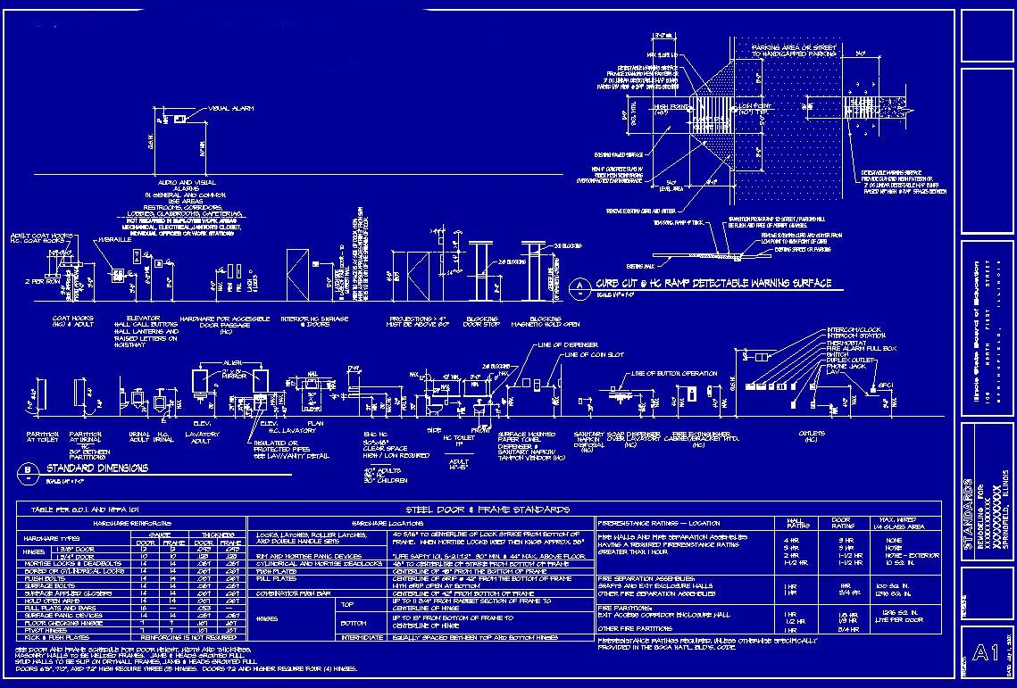
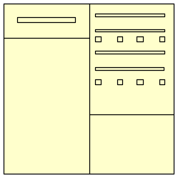
EA as “passive” repository
Who maintains this?
How does it provide value?

Slide 5
EA as “active” repository
Make EA part of the system!
- this requies SOA

Slide 6
What is RDF?
RDF (Resource Description Framework) is an infrastructure for:
  Encoding,
  Exchange and
  Distributing metadata
RDF Triple:
Subject
Predicate
Safety Harbor
Object
offers
Massage
Notes:
By capturing relationships between concepts RDF imposes a structure that provides for the unambigous expression of semantics

Slide 7


RDF: A distributed network of data!
RDF Files: “bags of triples”
Safety Harbor
…
Facial
offers
offeredBy
…
Safety Harbor
Massage
Safety Harbor
offeredBy
Facial
offers
Massage
Notes:
RDF Data model just has triples – there isn’t any more structure to a set of triples than the triples themselves. So you can see them as “bags” of triples.
Basic RDF operation – combine things from two (or more) bags; resolve similar references (same URIs) so that the result is a graph.

Slide 8
RDFS is RDF, too!
If the bags contain RDFS key symbols, then RDFS can infer certain conclusions
…
Resort
rdfs:subClassOf
offers
SafetyHarbor
offers
Spa
…
rdfs:domain
Spa
Massage
Safety Harbor
rdf:type
Resort
Activity
rdfs:subClassOf
rdfs:subClassOf
Spa
Treatment
rdf:type
rdfs:domain
offers
rdfs:range
rdf:type
Safety Harbor
offers
Massage
Notes:
You can have parts of schema in each bag, as well as data. RDF merge works the same on all of them.
RDFS semantics are given by inferencing – certain patterns of keywords produce certain new triples (inferencing)
Shown is definition of “range” – more on this to come in detailed RDFS section.

Slide 9
OWL can specify rich relationships: equivalence, inverse, unique, …
offers
SafetyHarbor
offeredBy
Facial
offers
offeredBy
Massage
offers inverseOf offeredBy
Notes:
Similarly, OWL adds new information in – shown is Inverse

Slide 10
OWL can describe classes, and determine membership
Planets
Solar System
=
= ∀ revolvesAround
The Sun
type
Mercury
revolvesAround
Notes:
Similarly, OWL adds new information in – shown is Inverse

Slide 11
Why use RDF for an Enterprise Architecture?
EA Requirements
RDF Features
Flexible, expressive models
Extensible in many different ways
Compatible with well-known modeling paradigms (e.g., OO)
Incremental Construction
Distribution of information
General graph modeling
Graph merging is a primitive operation
RDFS provides frame structure
“A little RDF goes a long way”
RDF is natively “of the web”
Notes:
Why use RDF for EA?

Slide 12
Why use RDF/OWL for a Service-Oriented Architecture?
SOA Requirements
OWL Features
Ability to describe entities for retrieval
Well-defined semantics of a service offering
Commonality and Variability analysis
DL Classification and Description Logic
Formal graph-theoretic semantics
“Tube map” combination

Slide 13
Incremental construction: A little RDF(S) goes a long way
gov: body
eGovOS: project
gov: department
eGOV: web service
gov: agency
eGOV: Remote Reporting
eGOV:Service Spec
gov: DoE
gov: FERC
gov: EPA
eGOV: capability
brm: s2citizens
brm:Energy
brm:Resource Mgmt
eGOV: Standard
brm: Line Of Business
brm: subfunction
brm: Business Area
A model of government agencies and departments. Such models are called Ontologies.
Notes:
FERC=Federal Energy Regulatory Commission
DoE=Dept of Energy
How do we keep track of the business of the government? A bit of RDF Schema describes agencies and departments (both of which are bodies); agencies and depts are related to one another somehow (details suppressed in this diagram; bold lines are domain/range schema things, dotted lines are direct isntance things)
Individual departments can use this to describe their agencies etc. as shown with DoE and FERC
then someone else could describe the business of government (the “business reference model”), and particular lines of business etc.
These can link to those agencies (on an as-desired basis). Forming a larger network.
The story continues in the same way; if someone else defines a model for capabilities and technologies, these could be linked in to the business lines.
Now we can draw on all these resources in a unified way, to answer questions like, “What collaborations are meaningful for a new government project? linking together agencies providing similar capabilities or supporting similar business functions.

Slide 14
Challenge: Commonality and Variability
Organization Domain Modeling (ODM)*
http://www.domainmodeling.com/stars.html#odm
Methodology for engineering sets of reusable assets
Stakeholder analysis
Exemplar study
Commonality and Variability modeling
Asset-base engineering
*not to be confused with the Ontology Definition Metamodel (ODM)
Notes:
When bringing communities together, the main challenge is to manage commonality and variability

Slide 15
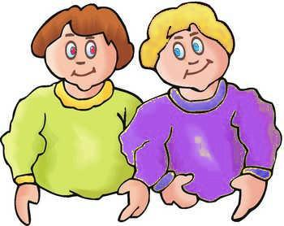
Challenge: Commonality and Variability
Exploit things in common . . .
… while respecting variation
Notes:
When bringing communities together, the main challenge is to manage commonality and variability

Slide 16
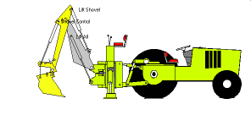

Commonality I – object models
Community
Apparel, Luggage and Personal Toiletry
Building and Construction Machinery
Clothing
Luggage, handbags, packs and cases
Heavy construction machinery
Hosiery
Suits
Paving Equipment
Luggage
Earth moving machinery
Business cases
Notes:
Object models – commonality at top, variation at bottom

Slide 17
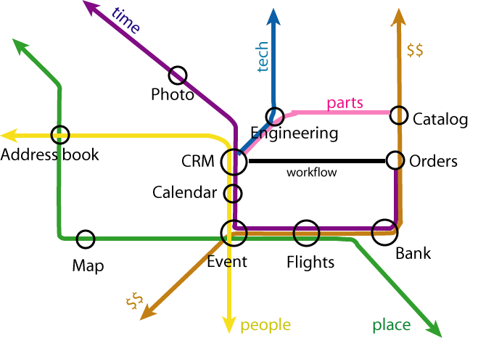
Commonality II – schema sharing
From Tim Berners-Lee,
ISWC 2003
Notes:
RDF is built to allow multiple models to share whatever parts they need
Just like London Tube map – each color indicates a particular model (stakeholder interest)
They can share parts of other models

Slide 18
Distributed data
RDF refers to Resources, identified by URLs.
This means that information about a single resource can come from many sources.
http://www.china.org/geography/rivers#Yangtze
<length>6300 kilometers</length>
<startingLocation>western China's Qinghai-Tibet Plateau</startingLocation>
<endingLocation>East China Sea</endingLocation>
http://www.china.org/geography/rivers#Yangtze
<name>Dri Chu - Female Yak River</name>
<name>Tongtian He, Travelling-Through-the-Heavens River</name>
<name>Jinsha Jiang, River of Golden Sand</name>
http://www.china.org/geography/rivers#Yangtze
<length>6300 kilometers</length>
<startingLocation>western China's Qinghai-Tibet Plateau</startingLocation>
<endingLocation>East China Sea</endingLocation>
<name>Dri Chu - Female Yak River</name>
<name>Tongtian He, Travelling-Through-the-Heavens River</name>
<name>Jinsha Jiang, River of Golden Sand</name>
A distributed network of data!
Example adapted from Costello and Jacobs, from XML to RDF

Slide 19
Service Capabilities supported by RDF/OWL
Service discovery (what service satisfies my needs?
Service composition (how do I combine services to get what I want?)
Service publication (how do I let people know about my service?)
Composition verification (how do I know that a combinaton of services does what I want?

Slide 20
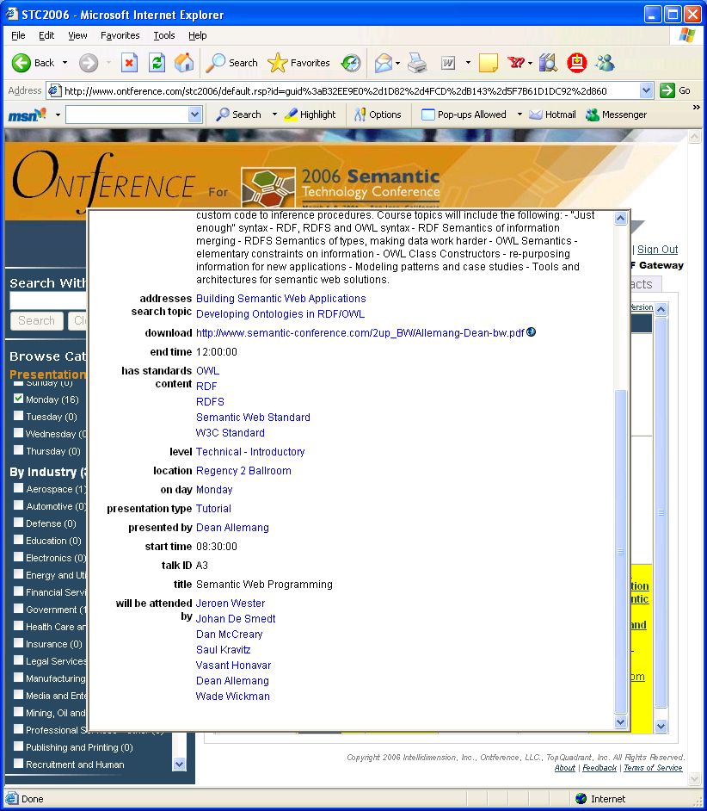
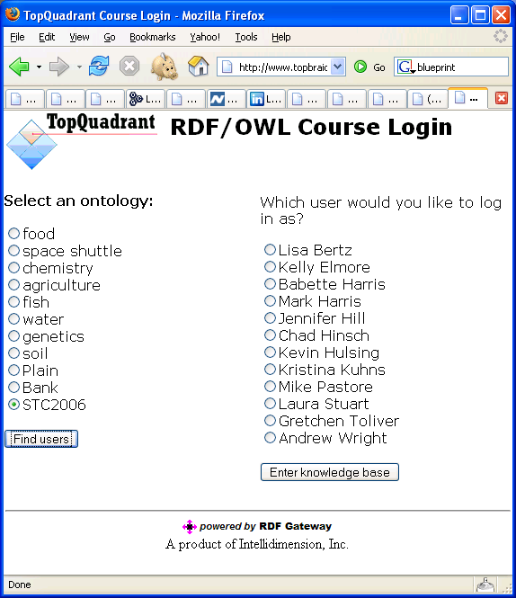
Service Policies
Technology can be in place, but without policy, no interoperation will happen
Privacy?
Policy is often more important than discovery, composition, description . . .
Notes:
Tell story about Ontference – RDF based application. One of the courses is my tutorial. Can we take the people who have registered in Ontference, and make them show up on the course roster? Sure! They’re both RDF!
But can we actually publish that information? What about personal privacy issues?

Slide 21
Case Study: Government Privacy Policy

Slide 22

Privacy Act of 1974
The US Gov’t has lots of information about YOU! (tax records, passport registration, visa applications, census information, etc.
Who is allowed to see this? Under what circumstances?
Policy is specified by Legislation – the Privacy Act of 1974

Slide 23
Privacy Act of 1974 in OWL
This policy can be represented in OWL, e.g.
“Disclosures to FBI for a criminal investigation must be accompanies by a court order” or
“Disclosures to the Bureau of the Census are granted, as long as the data is used only for statistical purposes”

Slide 24
Capabilities for Privacy Model
Extensible – allows new policies to be added, or policies to be used together
Distributed – policy representation is not likely to be in the same place as any particular disclosure request
Well-defined semantics – this is even better than most legislation!
Automation – inferences can do classification

Slide 25
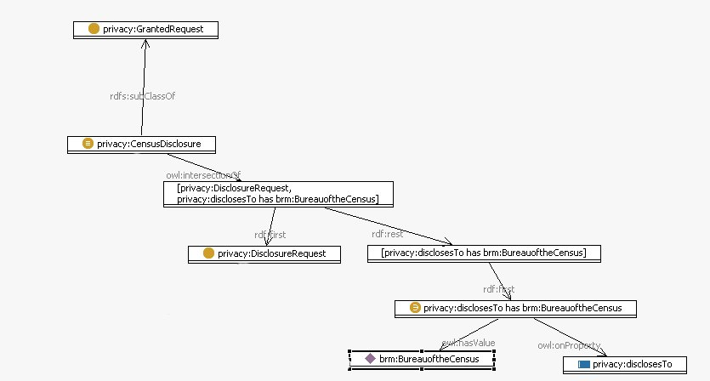
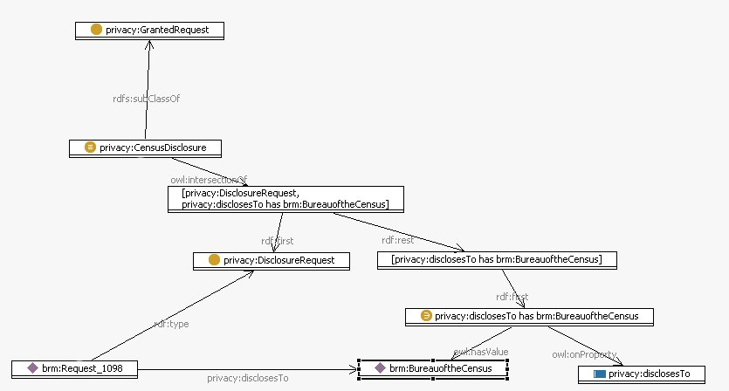
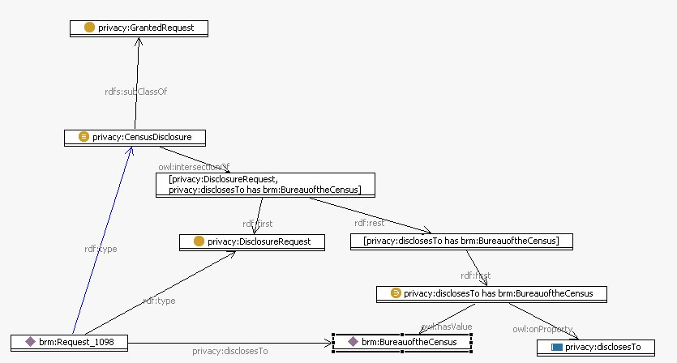
Privacy Policy Modeling - detail

Slide 26


Questions and Answers
Dean Allemang
E-mail: dallemang@topquadrant.com
www.topquadrant.com
724-846-9300

